Slide 1
Project 1: SAT and ACT Analysis
Ferdi Garcia

Slide 2
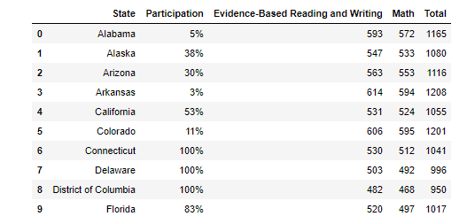
Snapshot of data loaded - SAT
SAT Records for 2017

Slide 3
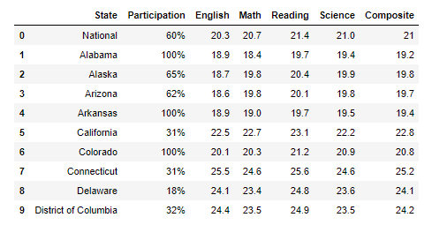
Snapshot of data loaded - ACT
ACT Records for 2017

Slide 4
Expected Score Ranges
SAT Score Ranges
Participation% - % of total students who took the exam in the state
Math : expected range between minimum of 200 to maximum of 800.
Evidence-Based Reading and Writing (EBRW) : expected range between minimum of 200 to maximum of 800.
Total Score : expected range between minimum of 400 to maximum of 1600.
Participation% - % of total students who took the exam in the state

Slide 5
Expected Score Ranges
ACT Score Ranges
Participation% - % of total students who took the exam in the state
English : expected range between minimum of 1 to maximum of 36.
Reading : expected range between minimum of 1 to maximum of 36.
Math : expected range between minimum of 1 to maximum of 36.
Science : expected range between minimum of 1 to maximum of 36.
Composite : calculated as the average of all subjects: expected range between min of 1 to max of 36

Slide 6
Data Errors Identified
SAT_2017
Maryland.Math score was 52; should be 524
ACT_2017
Maryland.Science score was 2.3; should be 23.2
Wyoming.Composite was 20.2x; should be 20.2

Slide 7
Available data in SAT
State
Participation (in %)
Evidence- Based Reading and Writing
Math
Total Score

Slide 8
Available data in ACT
State
Participation (in %)
English
Reading
Math
Science
Composite Score

Slide 9
Flow of Data
SAT 2017
Combined
2017
ACT 2017
Final
SAT 2018
Combined
2018
ACT 2018

Slide 10
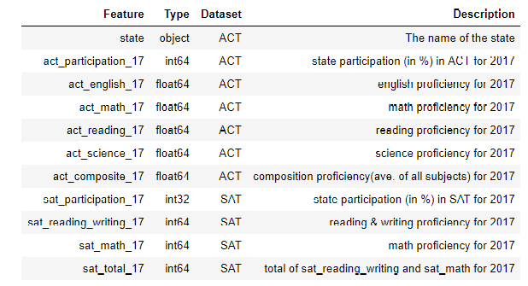
Data Dictionary

Slide 11
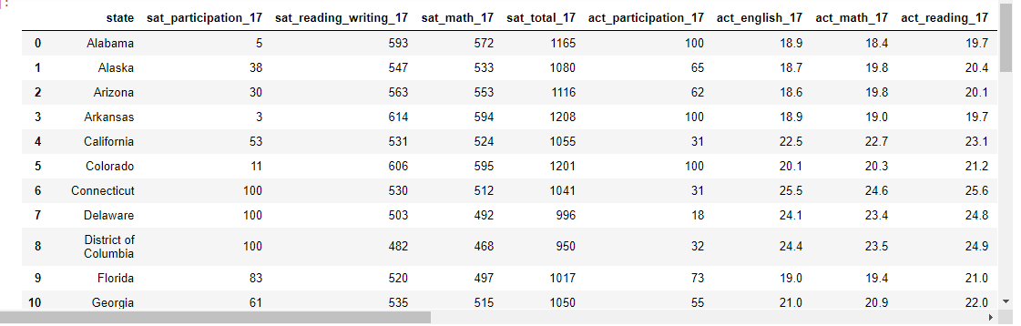
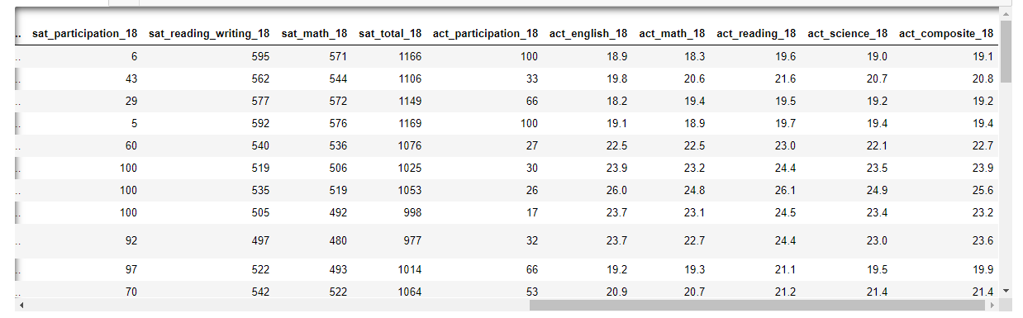
Data Layout of Final

Slide 12
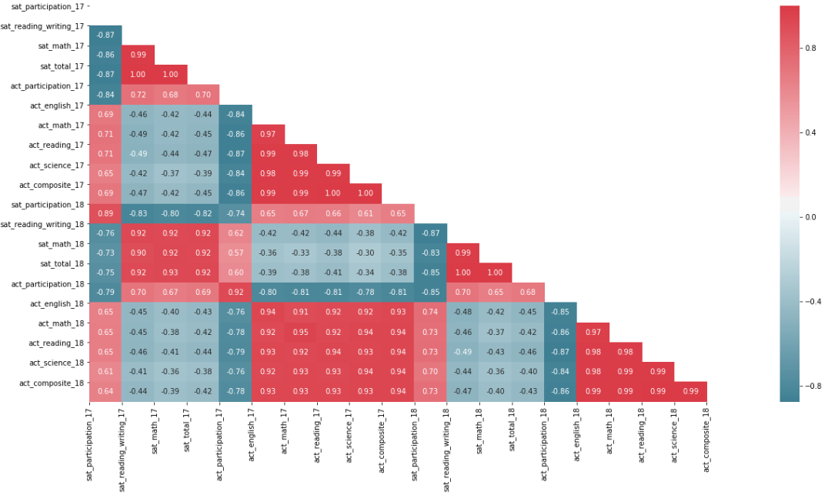
Visualizations – Seaborn’s Heatmap

Slide 13
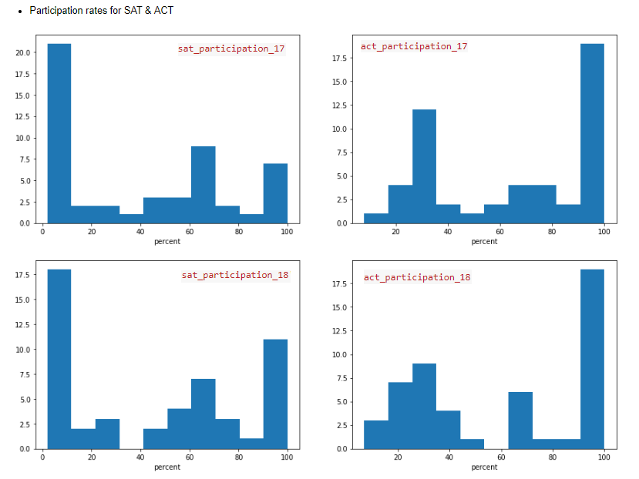
Visualizations – Histograms

Slide 14
Visualizations – Histograms

Slide 15
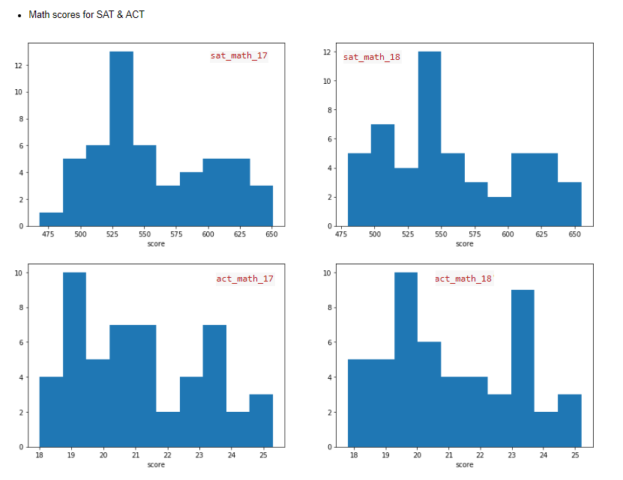
Visualizations – Histograms

Slide 16
Visualizations – Histograms

Slide 17
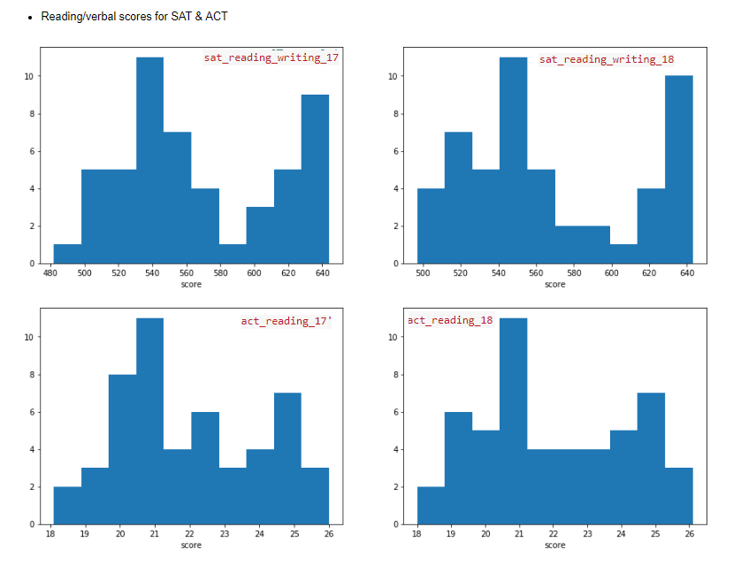
Visualizations – Histograms

Slide 18
Visualizations – Histograms

Slide 19
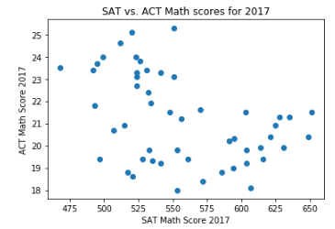
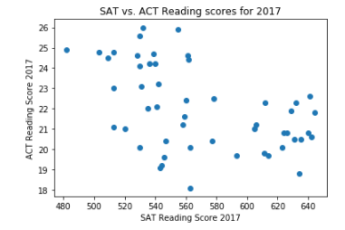
Visualizations – Scatter Plot

Slide 20
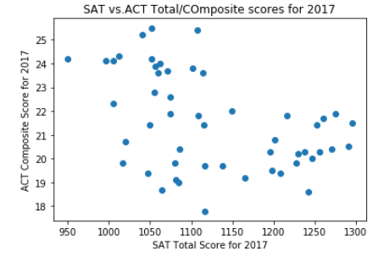
Visualizations – Scatter Plot

Slide 21
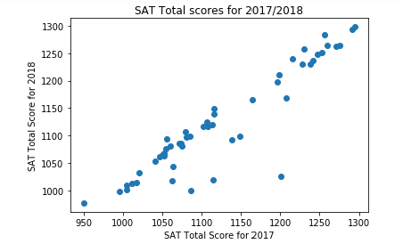
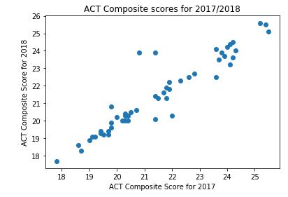
Visualizations – Scatter Plot

Slide 22
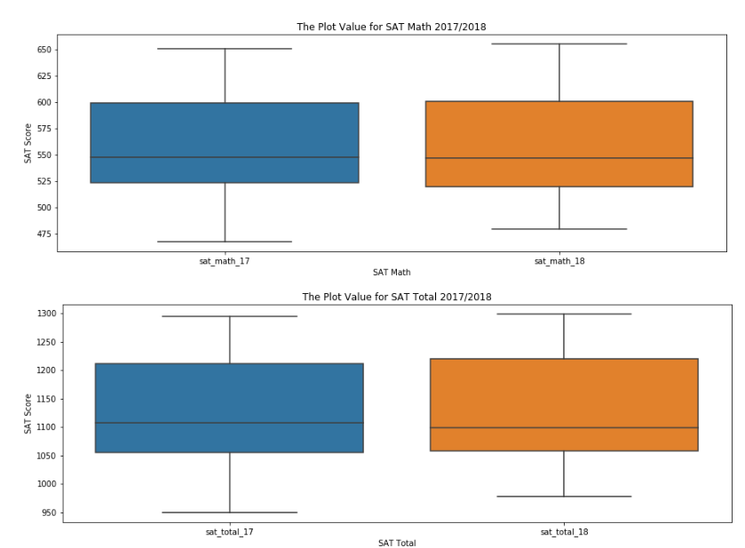
Visualizations – Box Plot

Slide 23
Visualizations – Box Plot

Slide 24
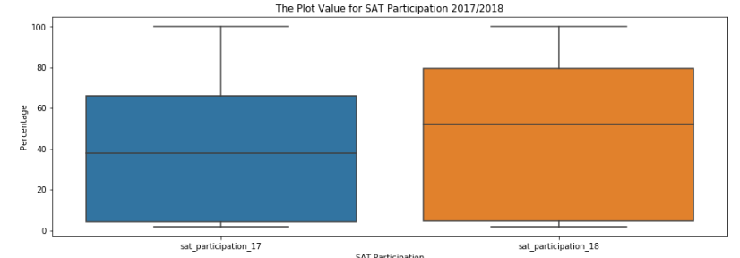
Visualizations – Box Plot

Slide 25
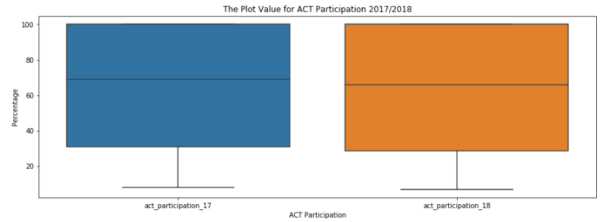
Visualizations – Box Plot

Slide 26
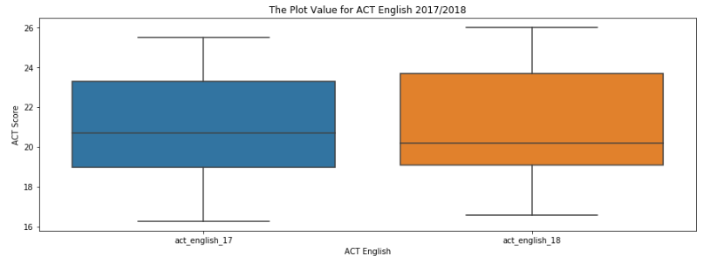
Visualizations – Box Plot

Slide 27
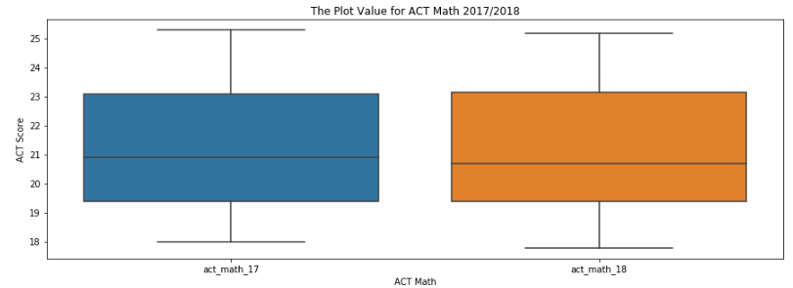
Visualizations – Box Plot

Slide 28
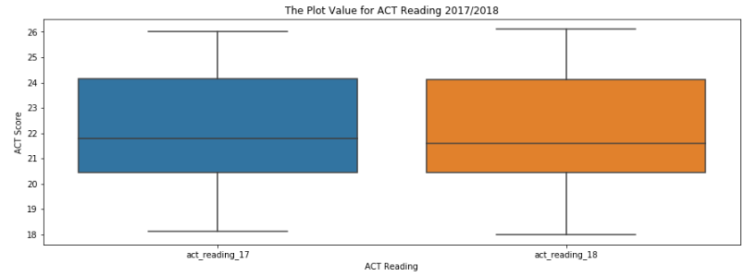
Visualizations – Box Plot

Slide 29
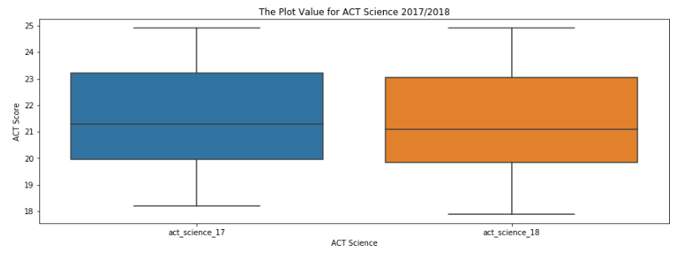
Visualizations – Box Plot

Slide 30
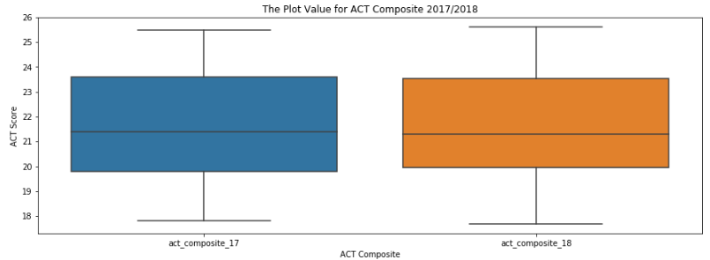
Visualizations – Box Plot

Slide 31
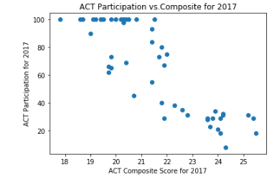
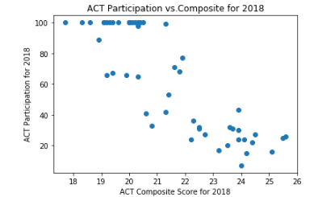
Visualizations – Additional Graphs

